Slide 1
CluedIn Fundamentals: Merging duplicate records
Proactively reduce duplicates by merging records with matching identifiers

Slide 2
Review data ingestion outcomes
Explore the concept of primary identifiers
Training agenda
Learn about merging by identifiers
Demo of merging duplicates from CRM and ERP

Slide 3

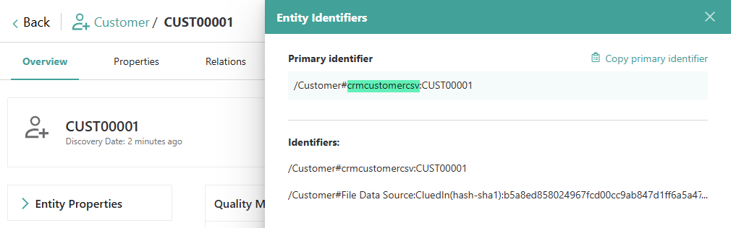
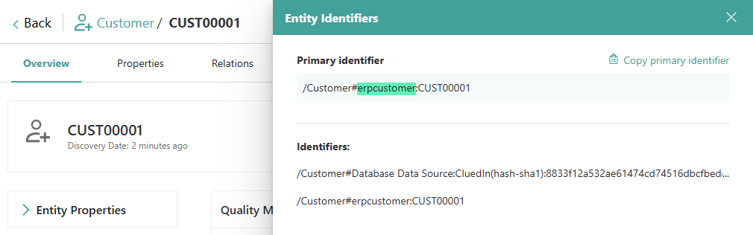

Data ingestion outcomes
As a result of ingesting CRM and ERP records, we now have 20,000 Customer golden records in the system.
Example of CRM record
Example of ERP record

Slide 4

What is a primary identifier?
Origin
2
A primary identifier is the mechanism CluedIn uses to establish the uniqueness of a golden record. During processing, when two records share the same primary identifier, CluedIn merges them into a single golden record.
/Customer#crmcustomercsv:CUST00001
1
3
Business domain
Unique identifier

Slide 5
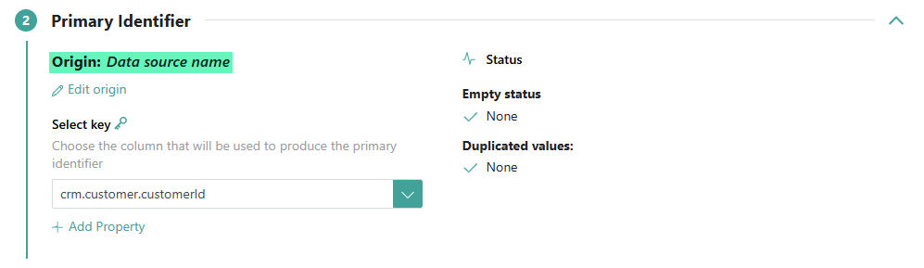
What is an origin?
The origin represents the source of a golden record. By default, when you map your data, the origin is automatically set to the name of the data source. However, in scenarios where multiple data sources use the same consistent, cross-system identifier—such as a shared Customer ID—it’s best to assign a common origin value during mapping.

Slide 6
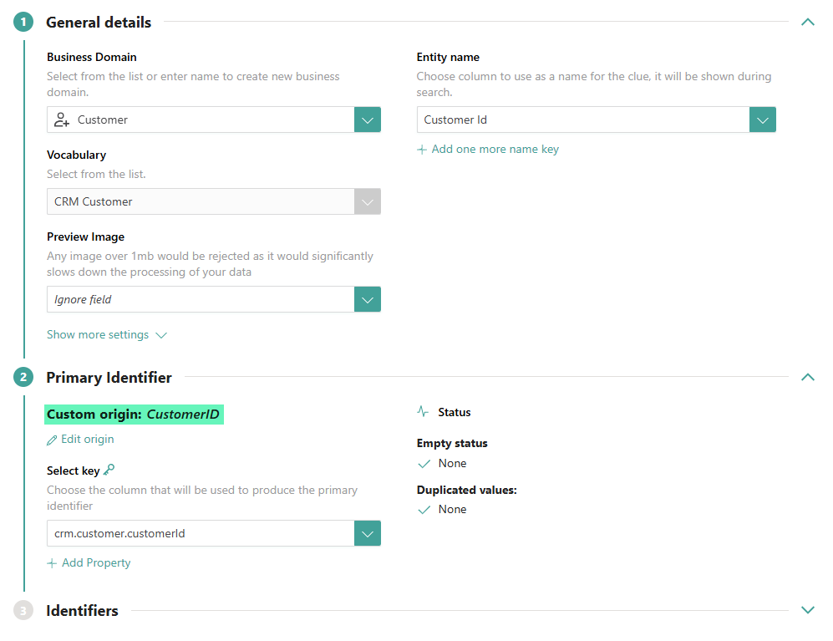
The process of merging duplicate CRM and ERP records by identifiers consists of three steps:
Remove processed records
Edit mapping to change the origin
How to merge duplicate CRM and ERP records?
Process data

Slide 7
DEMO: Merging duplicate CRM and ERP records by identifiers

Slide 8
Demo summary
You’ve seen how to:
Remove processed records
Edit mapping and change the origin
Re-process the data to generate golden records
Outcome:
Duplicate CRM and ERP records are merged into a consolidated golden record
Next step:
Pause the video and replicate the process.

Slide 9
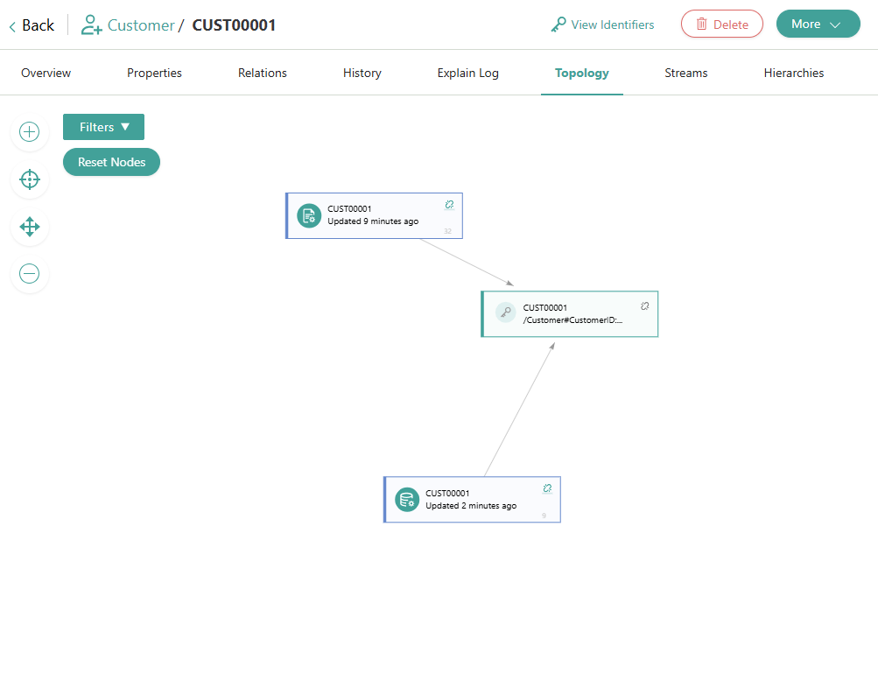


Learn more about merging by identifiers in our documentation portal.
Next session: Merging duplicate records using a deduplication project.
What’s next?

